Slide 1

PENETRATION TESTING

Slide 2
Software Analysis

Slide 3
Agenda
Preliminaries and motivations (revised)
Dynamic analysis
Static analysis
Hybrid approaches

Slide 4
General statement
Software Verification = Be sure that a piece of code complies with a specification under some assumptions

Slide 5
Mobile code scenario
Code producer
Code consumer
Source code
Assets
executable
Compiler
Execution environment

Slide 6
Producer perspective
Code producer
Code consumer
Both functional and non functional properties
Source code
Assets
executable
Compiler
Execution environment

Slide 7
Consumer perspective
Code producer
Code consumer
Non functional properties
only (typically)
Source code
Assets
executable
Compiler
Execution environment

Slide 8
Producer vs. consumer
Valuable resources: code, servers VS. files, data
Programming languages: high level VS. low level
Worst case scenario: misuse VS. malware

Slide 9
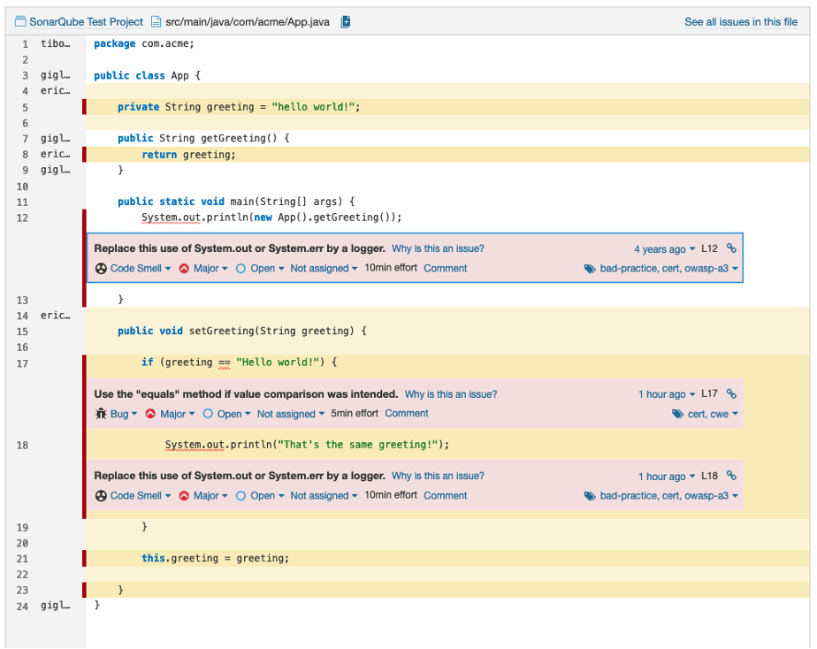
Code Analysis on Producer’s side

Slide 10
Mobile code: real life examples
Almost everywhere
E.g., PC, smartphones, cars, IoT, Web, ...
Favored by growing connectivity
Adapt a device over time by updating its functionalities
Supported by default on many modern OSes
App stores
Sometimes unexpected/undesired
E.g., firmware updates in a connected PLC

Slide 11
Third Parties
In many practical cases, the code is stored and distributed by a third party
Aka broker, distributor, ...
Although producer and consumer do not know each other they might trust the broker
TTP takes responsibility

Slide 12
Trusted Third Party
Code producer
TTP
Code consumer
Source code
Assets
Non functional properties
only (typically)
executable
Compiler
Execution environment

Slide 13
Considerations about the TTP
Often has strong incentives
E.g., reputation
Is in a strategic position
centralised controls (if it is the only code transition point)

Slide 14
Considerations about the TTP
Often has strong incentives
E.g., reputation
Is in a strategic position
centralised controls (if it is the only code transition point)
BUT
Enlarges the TCB of the consumer
Could (does!) ignore the requirements of the consumer

Slide 15
Google Play: a concrete example
The main store for Android applications
+3.5 million apps, 2 billion devices
Developers submit their apps to a review process before publication on the store
Takes up to 3 days now (few hours 1y ago)
The review process is semi-automatic
automatic tools + human analysts
The internals are undocumented
Most details are for the developers

Slide 16
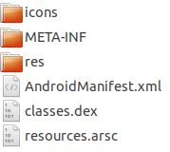
Android app distribution process
Code development:
Java (Scala, Kotlin, C++, ...) sources
resources (strings, DBs, libs, ...)
graphics & compat. (layouts, ...)
manifest (app info, permissions, ...)
Compilation and packaging
Bytecode from sources (.dex)
Binary encoding of resources
Returns a zipped archive (.apk)
Digital signatures (of each item)

Slide 17
Android app distribution process
App uploading:
Google play review process
App installation
App unpackaging and signatures checking
Dedicated folder for app code and resources
App runtime
Bytecode checked (e.g. for type safety)
Process isolation and sandboxing
Dynamic permission system

Slide 18
Understanding the behavior
Producer side: the behavior of the software is well known/understood
Consumer side: the behavior is partially (or even entirely) obscure
Two approaches:
ignore the behavior = black box analysis
try to understand it = white/gray box analysis

Slide 19
Reverse engineering
Going from (low level) code to (high level) specifications
(Manual) code inspection = read the code
Extremely hard because
Low level code is difficult to read
Often developers protect their code (obfuscation)

Slide 20
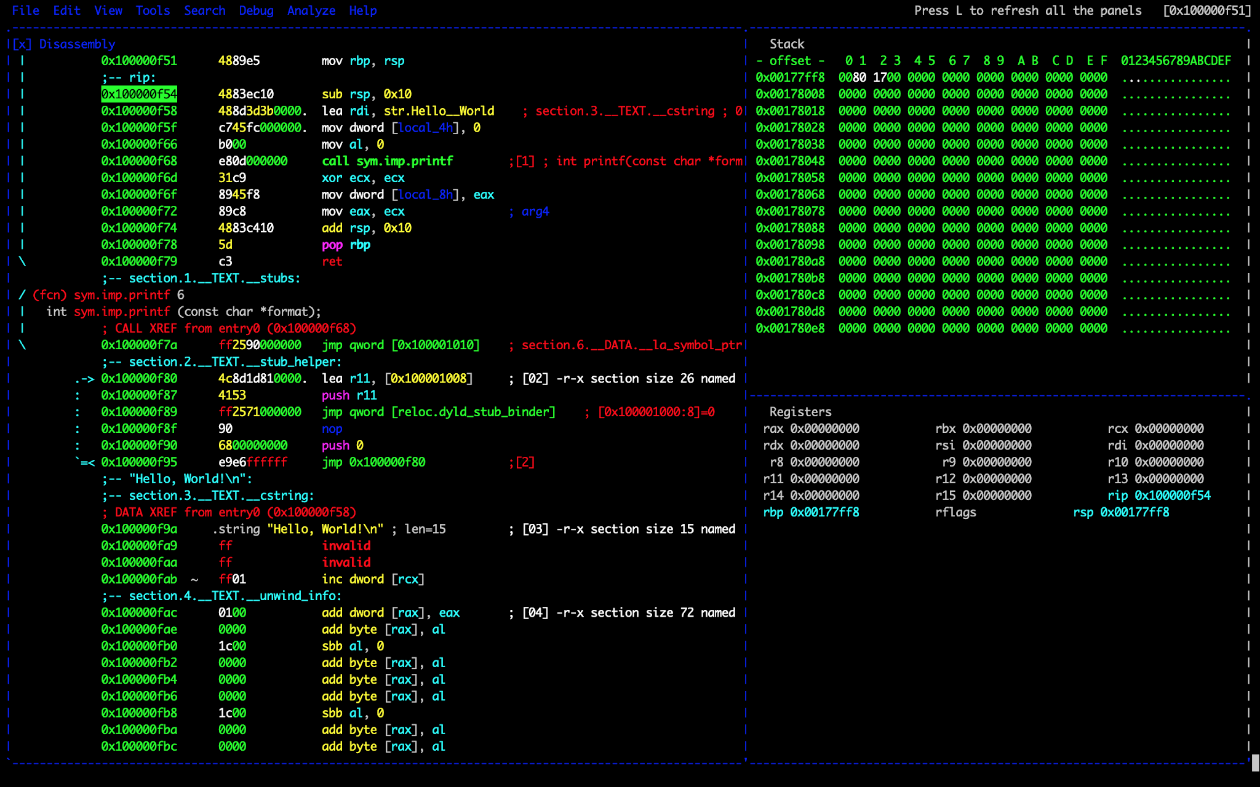
Reverse engineering (radare2)

Slide 21
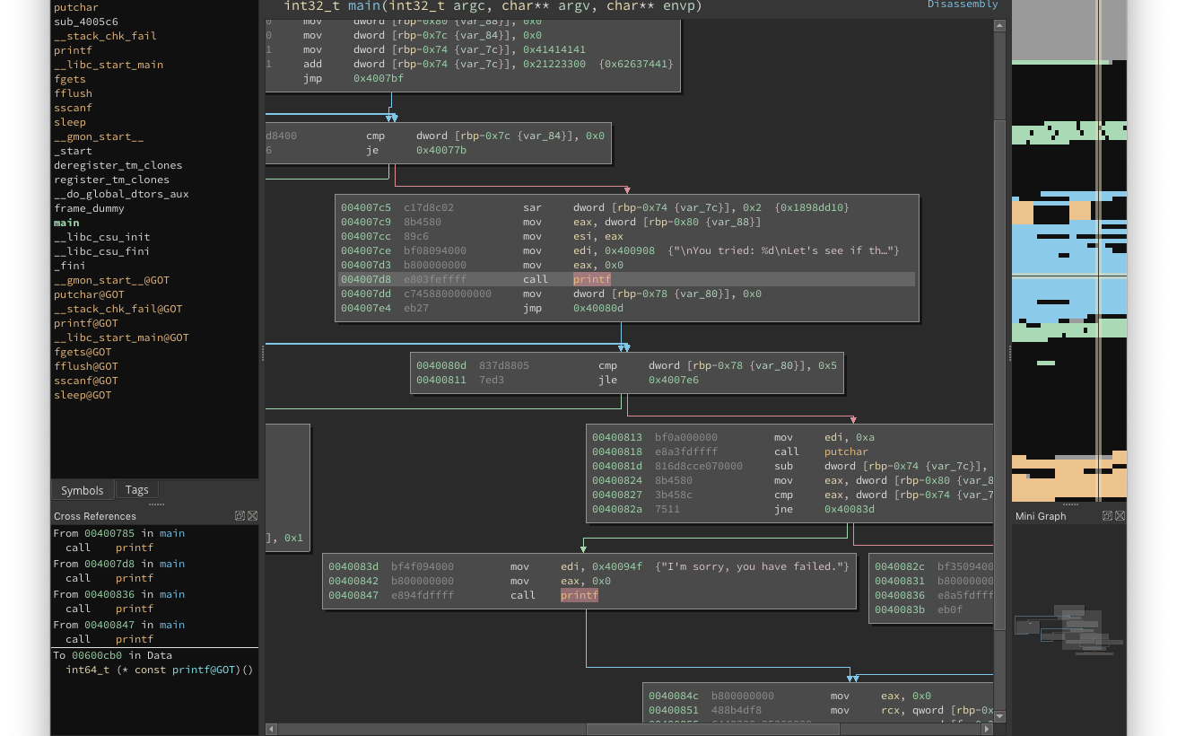
Reverse engineering (binary ninja)

Slide 22
Reverse engineering steps
Often starts from multiple representations
Graphs
control flow, call, dependencies, ...
Intermediate languages
assembly, bytecode, ESIL, smali, LLVM IR, …
Supported by other techniques
Term rewriting, execution/debugging, …

Slide 23
Reverse engineering: decompilation
Often we consider high level languages (e.g., C) as a satisfactory specification
Almost equivalent to having the source code
same working assumptions of the producer
Formally sound w.r.t. the compilation process
Compilers should preserve the semantics (i.e., the behavior) of programs
A compiler is a translator between two languages

Slide 24
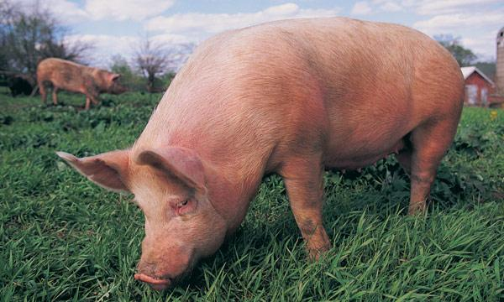

Compiler vs. Decompiler

Slide 25
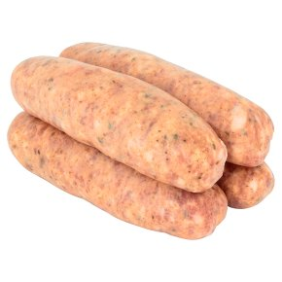
Compiler vs. Decompiler

Slide 26
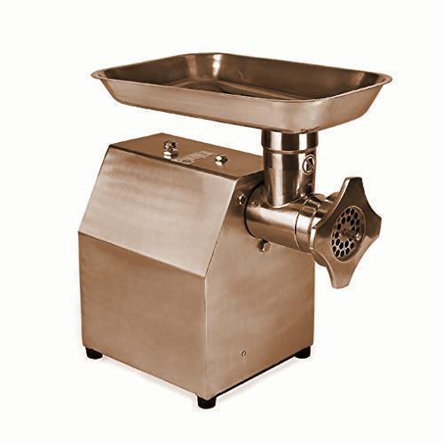
Compiler vs. Decompiler

Slide 27

Compiler vs. Decompiler

Slide 28
Decompilers limitations
Compilers remove any “decoration”
high level control structures (while vs. goto)
names (identifiers vs. registers and addresses)
debug information
Compilers optimize and transform the code
Code factorization and simplification
Common mistakes corrections
Unreachable code elimination
Different abstraction levels
pointers vs. addresses
heap vs. bit vector

Slide 29
Decompilers by language
bytecode (to Java): doable
bytecode itself is an intermediate representation
Many abstractions are preserved by the compiler
Examples: JD, Procyon, CFR, Jadx, ...
binary (to C): challenging
executables are hard to reverse
Even to C (not so “high level”)
Examples: IDA Pro, Ghidra

Slide 30
Ghidra
Demo time

Slide 31
References
http://java-decompiler.github.io/
https://www.radare.org/
https://ghidra-sre.org/
R. J. Canzanese, M. Oyer, S. Mancordis, M. Kam, “A survey of reverse engineering tools for the 32-bit Microsoft Windows environment”

Slide 32
Dynamic Analysis

Slide 33
Basic idea
Executing the code is often an effective way to understand it
Briefly, test the software to expose its flaws/behavior
Usually, testing is carried out by the producer
In some cases, the tester and the developer are distinct
good practice

Slide 34
Limitations
Testing requires proper facilities
Aka Test Execution Environment (TEE)
Running untrusted software is risky
E.g., think of a malware
Test cases are typically written from specifications and use cases
Unknown to the consumer
The quality of the analysis mostly depends on the test cases

Slide 35
TEE setup
Sandbox
Software under testing
Test cases
Probe
Test traces
Runtime support
Probe
Test Execution Environment

Slide 36
Test trace
A sequence of entries generated by a test
Such as an execution log
Entries depend on data collected by the probes
Deployed in either the SUT or the RS
If an operation is not under the scope of a probe it passes unobserved
Problem: what should we record?

Slide 37
Example: strace and ltrace
Standard linux utilities used to trace a program
strace for syscalls
ltrace for library calls
No sandbox, test cases TBD
Where are the probes?
strace: uses the ptrace syscall to force “debugging” SUT syscalls (probe in RS)
ltrace: inserts breakpoints in the Procedure Linkage Table (PLT) of the SUT (probe in SUT)

Slide 38
strace and ltrace
Demo time
Notes:
ltrace strings strings
strace strings strings

Slide 39
Considerations
strace and ltrace are perfectly fine if we are interested in syscalls and library calls
BUT
the behavior of a software may involve other aspects
E.g., internal data manipulation
test cases must be handwritten
software exploration/inspection is hard
why is the program behaving like this?

Slide 40
Fuzz testing
Problem: we don’t have test cases
Solution: just take some “random” input
But random is way too dumb
if(x == 42) do_nasty_things();
What about heuristics?
Can work, but extra rules must be defined
E.g., to make tests evolve
mutation-based
Or to reach a specific target
search-based

Slide 41
Fuzzing heuristics
Fuzzing heuristics can be classified according to their input generation strategies…
Random
Grammar-based
Mutation-based
… and their testing goals
Code coverage
Search-based

Slide 42
American Fuzzy Lop (AFL and AFL++)
A mutational fuzzing tool
Works on source and binary
afl-gcc, afl-clang vs. afl-llvm, afl-qemu, afl-unicorn
Security-oriented (slightly)
Predefined goals such as crashes
Instrumentation-based
puts probes inside the target code
e.g., at compile-time with afl-gcc
Works with complex program inputs
e.g., jpeg, xml, ...

Slide 43
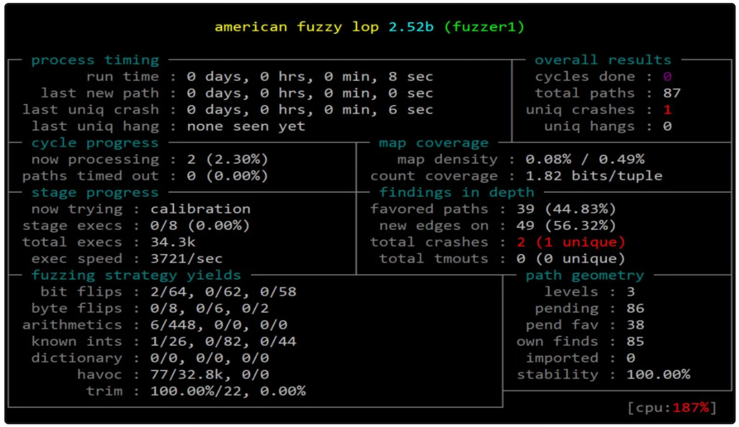
American Fuzzy Lop
Notes:
cd /home/gabriele/afl/tests/binutils-2.25 AFL_SKIP_CPUFREQ= afl-fuzz -i afl_in -o afl_out ./binutils/strings
afl-plot ~/afl/tests/binutils-2.25/afl_out ~/afl/tests/plots

Slide 44
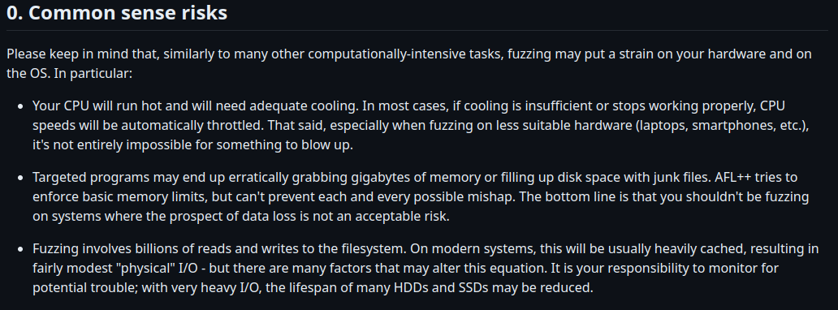

Slide 45
Android Monkey
A GUI events fuzzer for Android
works on both real devices and emulator
Simulate random user actions
click, type, scroll, ...
no search strategy, no test case mutation
Programmable via APIs

Slide 46
Selenium
A GUI testing framework for Firefox
and other major browsers
Drivers for most actions
click, type, scroll, ...
Fuzz logic must be implemented
no search strategy, no test case mutation
Programmable via APIs
Also records user’s sessions
in modifiable XML format

Slide 47
strace and ltrace
Demo time
Notes:
ltrace strings strings
strace strings strings

Slide 48
PyAutoGUI
A Python module for programmatically controlling the mouse and keyboard
works on major desktop environments
Fully programmable
Fuzz logic must be implemented
no search strategy, no test case mutation
pyautogui.typewrite('Hi!\n')
pyautogui.click(220, 810)

Slide 49
Considerations about fuzz testing
Fuzzing is fast
Good support to concurrency
Heuristics are useful
Take advantage of domain knowledge
BUT
Achieving good coverage is extremely hard
Real programs have too many states
Difficult to generate corner cases
Unless you have a great (!) heuristics

Slide 50
Debugging about fuzz testing
Debuggers are fundamental for code development
Can also be used for dynamic code analysis
But remember it is not a sandbox!
Using a debugger we can
Run the code instruction-by-instruction
Inspect memory and registers
Manipulate the program’s state

Slide 51
GNU debugger: quick reference
$ gdb ./crackme
(gdb) run
(gdb) breakpoint main
(gdb) b *0x080483fe
(gdb) disass main
(gdb) delete 1
(gdb) step
(gdb) ni
(gdb) si
(gdb) info registers
(gdb) print (int) $rbs
(gdb) x/10x 0xffffcc48
(gdb) kill
(gdb) quit
Load crackme and attaches gdb
Launch the execution
Set a breakpoint at the first instruction of main
Set a breakpoint at address 0x080483fe
Show disassembled code of main
Delete breakpoint number 1
Run till the next breakpoint
Only execute the next instruction (jump over call)
Like ni, but steps into called functions
Show all the registers (same as i r)
Evaluate and print expression (int) $rbs
Print 10 bytes (hex format) from 0xffffcc48
Terminate execution
Quit gdb

Slide 52
GUI Debugging about fuzz testing
Most debugger also have GUI
These are typically integrated in IDE
Mostly meant to be used by developers
Some alternatives exist for binary analysis
gdbgui (browser-based)
gdbinit (terminal-based)
gdb dashboard (extends gdbinit)

Slide 53
Instrumentation
Add instructions in a piece of code
programmatically
Base technique also used by fuzzers
To place probes before execution
Static instrumentation
Changes the behavior of the SUT
Yet in a controlled way

Slide 54
Dynamic instrumentation
Static instrumentation is fine when we know what we are looking for
Similar to adding log messages/printf
Dynamic instrumentation injects code at execution time
More similar to debugging

Slide 55
Frida overview
A dynamic instrumentation framework
Applies to Linux, Windows, Android, iOS
Works by injecting a JavaScript interpreter in the target program
Scripts can be submitted to the interpreter at runtime
Also accepts JSON requests
Provided with python and C APIs

Slide 56
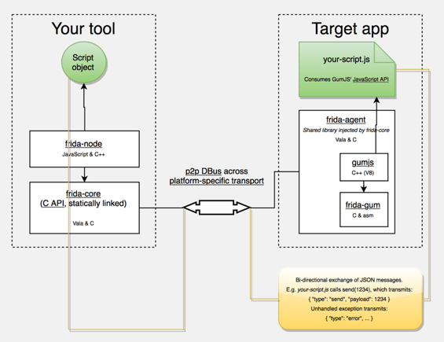
Frida architecture

Slide 57
Frida
Demo time

Slide 58
Considerations
Dynamic instrumentation is extremely powerful as a support to manual analysis
Generalizes the notion of debugging
Is the enabling technology for other techniques
E.g., dynamic program slicing
BUT
Most of the effort is left to the analyst

Slide 59
Dynamic Program Slicing
Analyzing an entire program may be difficult since its code includes many irrelevant instructions
A slice is a fragment of the entire code that only contains certain instructions
E.g., only network or filesystem operations
A dynamic slice contains the linear sequence of these instructions executed during a single test
A dynamic slice can be modified and re-executed
The rest of the code is ignored

Slide 60
References
https://www.fuzzingbook.org/
http://lcamtuf.coredump.cx/afl/
https://developer.android.com/studio/test/monkey
https://www.frida.re/

Slide 61
Static Analysis

Slide 62
Beyond dynamic analysis
Dynamic analysis can be very effective
BUT
Needs a human supervisor
Either directly (e.g., debugging) or indirectly (e.g., heuristics definition)
Cannot consider a program as a whole
Just a finite number of traces/test cases
Sometimes running is not an option
Even in a sandbox

Slide 63
Static analysis
Approximate the actual behavior of a program (abstraction) by means of a model
Verify whether the model satisfies or violate certain properties of interest
Apply the result of the verification to the program according to the characteristics of the abstraction procedure

Slide 64
Model vs code
The code is a baseline for abstraction
The code itself is a model
No abstraction, same verification complexity
Abstraction takes information away
The verification is simpler but less precise
Risk of false results
Abstraction technique may not be conservative
Results might not be portable to the code

Slide 65
Relationship between model and code
Under-approximation
The model represents a subset of the code
Risk of false negatives
Over-approximation
The model represents a superset of the code
Risk of false positives
No specific relationship
Risk of both false results

Slide 66
Android static permissions
The Android manifest file contains a list of the permissions that an App may request at runtime
Example: STORAGE and NETWORK
Under-approximation: disk read/write is unrelated to network connections
Over-approximation: disk data goes to the network, network data goes to the disk
Other: data from the network is stored, nothing is sent

Slide 67
Type of models
Software engineering: UML, BPMN, …
Used for the initial specification
Don’t have a formal semantics
Finite state machines
Relatively simple to generate and analyse
Not very expressive (only regular properties)
Process algebras
Expressive, good model of computation
Verification may be hard
Petri nets, stochastic models, ...

Slide 68
Memory: the bottleneck
The main source of approximation is the memory
Real programs deal with large amounts of data
Each memory configuration is a possible state of the program
Memory models use abstract representations

Slide 69
Memory model matters
Consider the following, multi-thread program at state (x = 0, y = 0)
t1: store(x, 1); load(r1, y);
t2: store(y, 1); load(r2, x);
Which of these are possible?
(r1 = 1, r2 = 1)
(r1 = 1, r2 = 0)
(r1 = 0, r2 = 0)

Slide 70
Memory model matters
Consider the following, multi-thread program at state (x = 0, y = 0)
t1: store(x, 1); load(r1, y);
t2: store(y, 1); load(r2, x);
Which of these are possible?
(r1 = 1, r2 = 1)
(r1 = 1, r2 = 0)
(r1 = 0, r2 = 0)
Answer: all of them (according to some memory model)

Slide 71
Concrete execution
A program state is it’s memory at runtime
Stack, heap, registers, …
Each location contains a value
Ex: reg r := 1337, address 0x4030c6 := ‘A’, ...
Concrete execution (run/debug) modifies values in the state

Slide 72
Concrete execution: example
void main(int argc, char **argv) { int c = argc * 2; if(argc < 7) c += argc - 1; else c -= argc + 3; if(c > 12) fail(); else success(); }

Slide 73
Concrete execution: example
void main(int argc, char **argv) { ▶️int c = argc * 2; if(argc < 7) c += argc - 1; else c -= argc + 3; if(c > 12) fail(); else success(); }
Name | Value
argc | 0x3
argv | 0x4B...

Slide 74
Concrete execution: example
void main(int argc, char **argv) { int c = argc * 2; ▶️if(argc < 7) c += argc - 1; else c -= argc + 3; if(c > 12) fail(); else success(); }
Name | Value
argc | 0x3
argv | 0x4B...
c | 0x6

Slide 75
Concrete execution: example
void main(int argc, char **argv) { int c = argc * 2; if(argc < 7) ▶️ c += argc - 1; else c -= argc + 3; if(c > 12) fail(); else success(); }
Name | Value
argc | 0x3
argv | 0x4B...
c | 0x6

Slide 76
Concrete execution: example
void main(int argc, char **argv) { int c = argc * 2; if(argc < 7) c += argc - 1; else c -= argc + 3; ▶️if(c > 12) fail(); else success(); }
Name | Value
argc | 0x3
argv | 0x4B...
c | 0x8

Slide 77
Symbolic execution: intuizione
Run programs in symbolic states where constraints are used instead of values
Constraints can contain symbolic variables
A single symbolic execution explores all the concrete executions visiting the same instructions
At each conditional we decide the branch to take
Constraints must be satisfiable
(ex. x > 7 && x < 3 is not)
Each solution to the constraints in memory is a concrete execution

Slide 78
Symbolic execution: example
void main(int argc, char **argv) { int c = argc * 2; if(argc < 7) c += argc - 1; else c -= argc + 3; if(c > 12) fail(); else success(); }

Slide 79
Symbolic execution: example
void main(int argc, char **argv) { ▶️int c = argc * 2; if(argc < 7) c += argc - 1; else c -= argc + 3; if(c > 12) fail(); else success(); }
Constraints
argc = X
argv = Y

Slide 80
Symbolic execution: example
void main(int argc, char **argv) { int c = argc * 2; ▶️if(argc < 7) c += argc - 1; else c -= argc + 3; if(c > 12) fail(); else success(); }
Constraints
argc = X
argv = Y
c = 2*argc

Slide 81
Symbolic execution: example
void main(int argc, char **argv) { int c = argc * 2; if(argc < 7) ▶️ c += argc - 1; else c -= argc + 3; if(c > 12) fail(); else success(); }
Constraints
argc = X
argv = Y
c = 2*argc
argc < 7

Slide 82
Symbolic execution: example
void main(int argc, char **argv) { int c = argc * 2; if(argc < 7) c += argc - 1; else c -= argc + 3; ▶️if(c > 12) fail(); else success(); }
Constraints
argc = X
argv = Y
c = 2*argc + argc - 1
argc < 7

Slide 83
Symbolic execution: example
void main(int argc, char **argv) { int c = argc * 2; if(argc < 7) c += argc - 1; else c -= argc + 3; if(c > 12) ▶️ fail(); else success(); }
Constraints
argc = X
argv = Y
c = 2*argc + argc - 1
argc < 7
c > 12

Slide 84
Symbolic execution: example
void main(int argc, char **argv) { int c = argc * 2; if(argc < 7) c += argc - 1; else c -= argc + 3; if(c > 12) ▶️ fail(); else success(); }
Constraints
argc = X
argv = Y
c = 2*argc + argc - 1
argc < 7
c > 12
Any pair of values for X and Y that satisfies the constraints will lead to fail()!

Slide 85
Symbolic execution: example
void main(int argc, char **argv) { int c = argc * 2; if(argc < 7) c += argc - 1; else c -= argc + 3; if(c > 12) ▶️ fail(); else success(); }
Constraints
argc = X
argv = Y
c = 2*argc + argc - 1
argc < 7
c > 12
Any pair of values for X and Y that satisfies the constraints will lead to fail()! E.g., X = 5

Slide 86
SMT constraints solvering
Satisfiability Modulo Theories (SMT): find solutions to sets of constraints (referring to different theories)
If the there are not valid solutions, the solver returns UNSAT
Otherwise a model is returned
model == valid assignment of values to variables
Z3 is the SMT solver by Microsoft (quite powerful)
DEMO

Slide 87
Symbolic execution tools
Triton
Dynamic symbolic execution engine for binaries
Dynamic + symbolic = concolic (further to come)
Based on Intel’s dynamic instrumentation tool PIN
Manticore
Pure symbolic execution engine for binaries, WASM and Solidity (Ethereum)
Klee
Pure symbolic execution engine for C sources
Angr
Pure symbolic execution engine for binaries

Slide 88
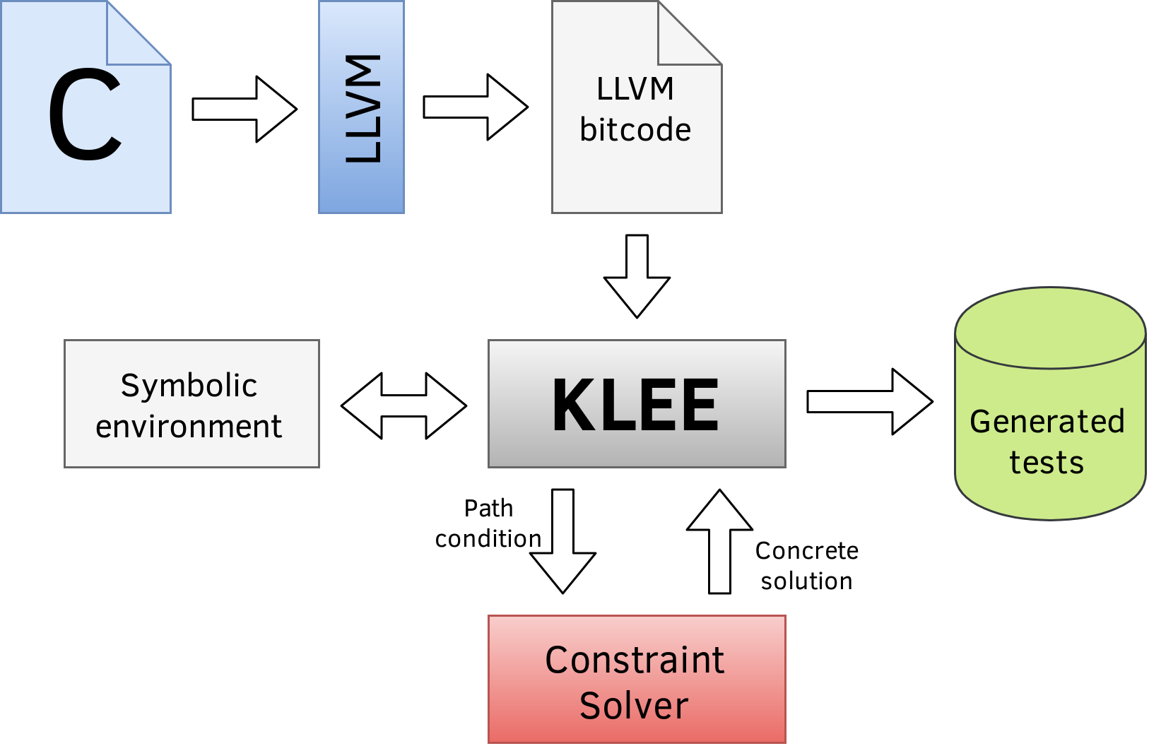
Klee in a nutshell
A re-implemented llvm/bitcode interpreter
Using symbolic semantics
Provided as a C library
Need to include klee.h in sources

Slide 89
Frida
Demo time
Notes:
Dropbox/Didattica/UNIFI/2023-24/Pentesting/Extra/Klee
=== DOCKER RUN ===
docker run --rm -ti --ulimit='stack=-1:-1' klee/klee
docker cp example.c CONTAINERID:/home/klee/example.c
=== KLEE EXEC ===
clang -emit-llvm -c example.c
klee example.bc
ktest-tool klee-last/test000001.ktest

Slide 90
Angr in a nutshell
Angr
Mostly written in Python
Translates binaries in VEX (Valgrind) IR
Supports Win/Linux/Mac and several architectures
Intel x86/64, ARM, AMD, PPC, MIPS
Basically a collection of Python modules
angr: main collection of scripts pyvex: bindings to VEX IR claripy: wrapper for SMT solvers cle: binary loader (loads everything!)

Slide 91
Loading a binary
import angr project = angr.Project("crackme", auto_load_libs=False)

Slide 92
Loading a binary
import angr project = angr.Project("crackme", auto_load_libs=False) cfg = project.analyses.CFGFast()

Slide 93
Loading a binary
import angr project = angr.Project("crackme", auto_load_libs=False) cfg = project.analyses.CFGFast() fund = dict(project.kb.functions)

Slide 94
Symbolic reachability (by address)
import angr project = angr.Project("crackme", auto_load_libs=False) sm = project.factory.simulation_manager()

Slide 95
Symbolic reachability (by address)
import angr project = angr.Project("crackme", auto_load_libs=False) sm = project.factory.simulation_manager() path = sm.explore(find=0x4007eb)

Slide 96
Symbolic reachability (by address)
import angr project = angr.Project("crackme", auto_load_libs=False) sm = project.factory.simulation_manager() path = sm.explore(find=0x4007eb)
target_state = sm.found[0]

Slide 97
Symbolic reachability (by stdout)
import angr project = angr.Project("crackme", auto_load_libs=False) sm = project.factory.simulation_manager() path = sm.explore(find=lambda s: “hi” in str(s.posix.dumps(1)))
target_state = sm.found[0]

Slide 98
Demo time
(angr + angr management)
https://tinyurl.com/mr2b2fs2

Slide 99
Symbolic Execution is NOT the ultimate tool
SE is an ideal technique! But it has a strong limitation on scalability
SMT solving is NP-hard (few extra constraints exacerbate the problem)
Constraints grow exponentially w.r.t. code
So:
SE must be used wisely (e.g. Symbolic debugging)
SE may be combined with other techniques
Notes:
Limiti specifici di Angr
Memoria finita: massimo 255 path simbolici
Supporto alle librerie: solo le libc e poco altro sono state implementate, per le altre librerie dovete importarle (costo delle analisi esplode!) è definirvi a mano degli hook

Slide 100
Concolic testing
Combine standard and symbolic program execution
Concolic = concrete + symbolic
Standard execution for speed
The fastest possible
Symbolic execution for accuracy
The most accurate
Different composition strategies

Slide 101
Concolic execution: basic
run some tests (initially on random input)
find a conditional branch that was not taken
symbolically run the test to force the new branch
find concrete values and enqueue a new test
goto 1.

Slide 102
Concolic execution: Driller
run AFL (initially from some random tests)
Set “stagnation” as stopping condition
If AFL did not explore the whole program
Find a branch B that was never explored
∄ such a B? terminate!
Pick a test that hit the branch condition
Symbolically force the test to take B
success? enque the new test and goto 1.
failure? skip B and goto 2.a.

Slide 103
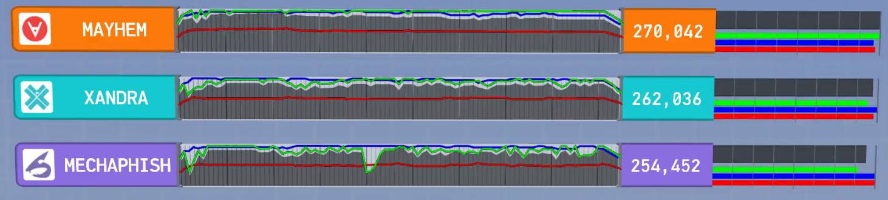

Concolic execution: how good is it?
The 3 winners of CGC (2016) were all using concolic execution
3.75 M$ total prizes
Driller/Angr got 3rd place

Slide 104
Final considerations
Software verification is tough in general
With others’ software it is even nastier
Nowadays (pretty much) handicraft
VAPT, forensics, malware dissection
Automatic techniques are needed!
Even for limited classes of SW, bugs and vuln.
ML won’t save us
Not compatible with the threat model
Adversarial attacks

Slide 105
Honorable mention
pwntools (http://pwntools.com/) is a collection of various utilities for binary analysis
Mainly used for CTF
Includes modules for
Debugging
Exploitation
Shellcode
Return oriented programming
…

